Slide 1
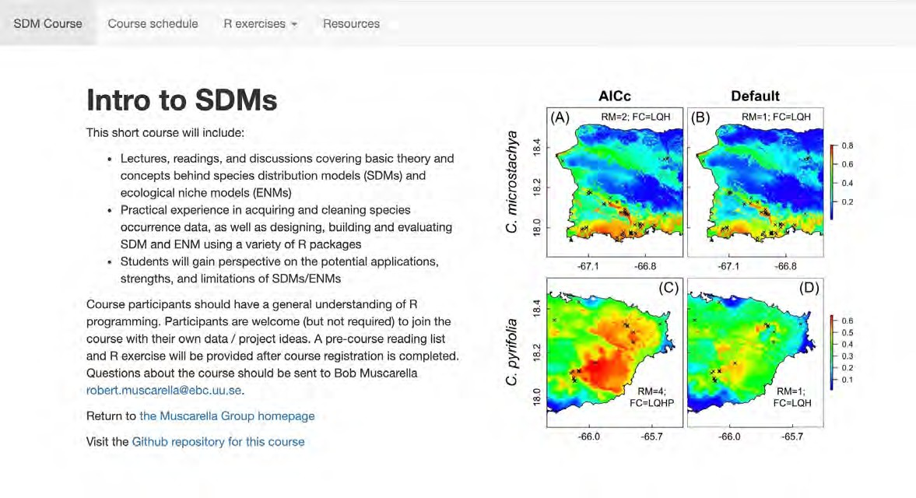
Introduction to SDMs:
Theory and practice in R
Bob Muscarella
Sapienza University, Roma June 9-11
Course website: https://bobmuscarella.github.io/SDM-course/index.html

Slide 2
Who am I?
Associate professor in Plant Ecology & Evolution at Uppsala University
Tropical forest ecologist, (functional) diversity, forest dynamics, natural and anthropogenic disturbance
Interest in applying SDMs to understand broader context of diversity patterns, and how species respond to environmental conditions
Interest in methodological development of SDMs (ENMeval R package)

Slide 3

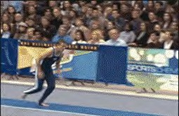
Course overview
3 day short course with emphasis on practical exercises
General understanding of main concepts + hands-on experience
Use these days as a spring board for continued learning
Not like this…
Like this…

Slide 4

Learning objectives
Familiar with basic theory, concepts, and terminology of SDMs / ENMs
Design, build and evaluate SDMs / ENMs in R
Understand the strengths and limitations of SDMs / ENMs
Use SDMs/ENMs to describe and predict species distributions in space + time

Slide 5

Introductions (~ 2 min each)
Name?
Department?
Year of studies?
Research project?
Prior experience with R and SDMs?
What do you hope to gain from this course?
Anything else?

Slide 6
pausa caffè

